Slide 1

Professional Development Activity Series
Four Half-Day Sessions
Classroom Management (Part 1):
Learning the Components of a Comprehensive Behavior Management Plan
The IRIS Center is funded through a cooperative agreement U.S. Department of Education, Office of Special Education Programs (OSEP) Grant #H325E120002. The contents of this presentation do not necessarily represent the policy of the U.S. Department of Education, and you should not assume endorsement by the Federal Government. Project Officer, Sarah Allen.
Notes:
Time: 2 Minutes
FYI:
Cover any housekeeping items before beginning.
Make sure everyone is able to access the IRIS Website and locate the module.
Identify partners and groups so that participants will know who to turn to when instructed to “share with partner.”
Facilitator Notes: This professional development series uses the IRIS online Module Classroom Management (Part 1) to help teachers create the foundation of a comprehensive behavior management plan. Individual teachers, grade-level teams, or content-area teams would benefit from working through the activities in this module together as they develop a common understanding of how to build comprehensive behavior management plans for their students.

Slide 2

PD Activities
During this PD activity series, you will engage in:
Twelve hours of face-to-face training that follows adult learning theory
IRIS Module, Classroom Management (Part 1)
Application of new knowledge and skills
Guided discussion for deeper learning
Peer-to-peer consultation and feedback
Development of a comprehensive classroom behavior management plan collaboratively with peers
Notes:
Time: 1 minute
Facilitator Notes: This PD series was created to provide twelve total hours of face-to-face training, broken into four sessions. The pedagogy of this PD series is based on adult learning theory, recognizing the need of adults to make the best use of their time and apply their knowledge and skills with their colleagues during the PD time.
FYI:
Teachers will interact with the online module during the training to apply their knowledge and skills using the tools and resources provided. Access to the Internet is necessary because the content is found on the IRIS Center’s Website.
The Participant’s Guided Notes for this PD series structures the face-to-face activities. Activities encourage grade-level or content-area teams to work together to create common behavioral expectations and plans.
Through peer-to-peer discussions and problem solving, teachers and teaching teams will build the foundation for their own behavior management plans.

Slide 3
Objectives
After completing this PD activity series, you will be able to:
Demonstrate knowledge of the core elements of an effective comprehensive behavior management plan
Use these core components to develop a comprehensive behavior management plan
Develop a grade-level or content-area plan
Develop, discuss, and receive feedback on elements of the plan
Participate in instruction that is focused on adult learning theory
Notes:
Time: 1 minute
Facilitator Notes: Read the objectives on the screen.

Slide 4
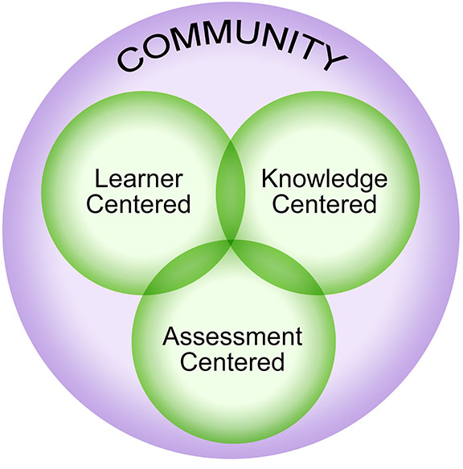
How People Learn (HPL)Theory
Four Lenses to Enhance Learning
Learner Centered: Instruction tailored to the learners’ prior knowledge, previous experience, misconception, and preconceptions
Knowledge Centered: Understanding of the content focused on comprehension and application of new knowledge
Assessment Centered: Frequent monitoring of progress in order to provide feedback
Community Centered: Recognition that learners are members of multiple communities providing opportunities to share and learn from each other
Notes:
Time: 2 minutes
Facilitator Notes: The IRIS resources are based on research by Harris, Bransford, and Brophy (2000), focusing on the four overlapping lenses that enhance the learning process. These four lenses highlight the fact that people are more likely to learn if the information is learner centered, knowledge centered, assessment centered, and community centered.
FYI:
When teachers from the same school community share and learn together, they are more engaged. Also, when learning is tailored to educator’s prior knowledge and experiences, the experience is more meaningful.
This PD series provides opportunities for teachers and teaching teams to learn within their own community, apply their learning to their own classrooms, and receive feedback on their learning from their peers and PD leaders.

Slide 5
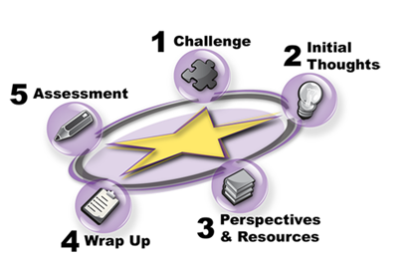
The STAR Legacy Cycle
Five components of the STAR Legacy Cycle
Challenge: Case-based scenario to invite inquiry
Initial Thoughts: Generate ideas to explore the Challenge
Perspectives & Resources: Access resources relevant to the Challenge as nuggets of information
Wrap Up: Summary and opportunities to review Initial Thoughts
Assessment: Assessment opportunities to apply new knowledge
Notes:
Time: 2 minutes
Facilitator Notes: The STAR (Software Technology for Action and Reflection) Legacy model was designed to help introduce and balance the features of learner, knowledge, assessment, and community centeredness for instructional settings.
FYI:
The model of this training and all the IRIS Modules use this format to anchor learning. The cycle is easy to understand and pedagogically sound.
The structure of the IRIS STAR Legacy Modules incorporates these five components: Challenge, Initial Thoughts, Perspectives & Resources, Wrap Up, and Assessment in order to balance the four How People Learn lenses.

Slide 6
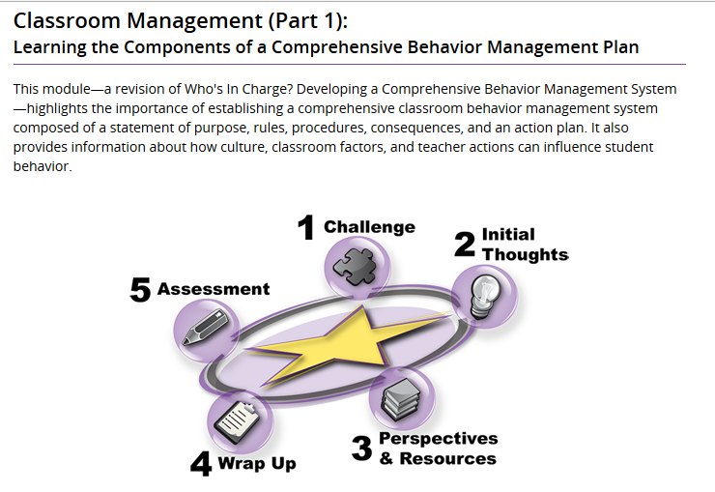
Classroom Management (Part 1)
Notes:
Time: 1 minute
Facilitator Notes: In the Classroom Management (Part 1) Module, teachers learn the key components of establishing a comprehensive behavior management system: statement of purpose, rules, procedures, consequences, and action plan.

Slide 7
Agenda: Four Half-Day Sessions
Session 1
Effects of Disruptive Behavior
Cultural Influences on Behavior
Classroom and Teacher Influences on Behavior
Session 3
Components of a Comprehensive Behavior Management Plan (Continued)
  Procedures
  Consequences: An Introduction
  Positive Consequences
  Negative Consequences
Session 2
Introduction to Comprehensive Behavior Management Plans
Components of a Comprehensive Behavior Management Plan
  Statement of Purpose
  Rules
Session 4
Components of a Comprehensive Behavior Management Plan (Continued)
  Action Plan
Practice with the Components
Wrap Up
Assessment
Notes:
Time: 2 minutes
Facilitator Notes: This is a four-session series:
Session 1 (2 hours, 8 minutes)
Session 2 (2 hours, 44 minutes)
Session 3 (2 hours, 45 minutes)
Session 4 (3 hours, 3 minutes)
FYI:
In Session 1, teachers learn the effects of disruptive behavior and how culture, the classroom, and the teacher can influence behavior.
In Session 2, teachers and teams will learn the first essential steps to building a comprehensive behavior management plan.
In Session 3, teachers learn more components of a comprehensive plan.
In Session 4, teachers and teams learn the rest of the components and how to develop an action plan for implementation. They also reflect on the changes in their learning during the Wrap Up and Assessment.

Slide 8
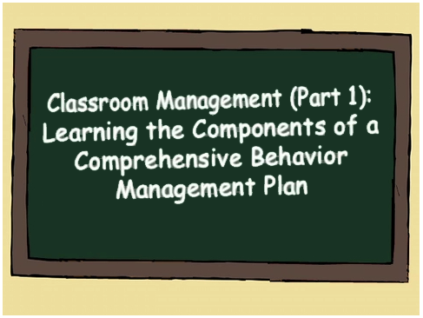
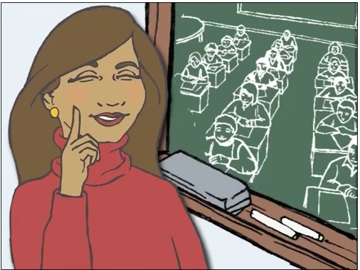
Challenge
Ms. Rollison’s first day of teaching is here… but she is worried about what to do if behavior problems arise…
Notes:
Time: 3 minutes
Facilitator Notes: Direct participants to watch the Challenge video in the module. The video is 2 minutes and 24 seconds long.
FYI: Teachers can download the transcript PDF as a note-taking guide.

Slide 9
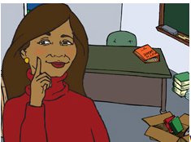
Reflect and respond to the Initial Thoughts questions:
Initial Thoughts
What does Ms. Rollison need to understand about student behavior?
What can Ms. Rollison do to increase the chances that her students behave appropriately in class?
Notes:
Time: 8 minutes
Facilitator Notes:
Direct teachers to move to the Initial Thoughts page in the module.
Have them reflect on the questions and write their responses in their Participants’ Guided Notes. (3 minutes)
Partner Work: Teachers should share their responses with their partners to identify similarities and differences. (5 minutes)

Slide 10

Perspectives & Resources
After completing the entire Perspectives & Resources section, you should:
Understand how disruptive behavior negatively affects instruction and learning
Explain how culture can influence behavior
Identify and describe the core components of a comprehensive behavior management system
Develop a comprehensive behavior management plan
Notes:
Time: 1 minute
Facilitator Notes:
Direct teachers to go to the Perspectives & Resources section of the module.
Review the objectives for this training series:
Understand how disruptive behavior negatively affects instruction and learning
Explain how culture can influence behavior
Identify and describe the core components of a comprehensive behavior management system
Develop a comprehensive behavior management plan

Slide 11
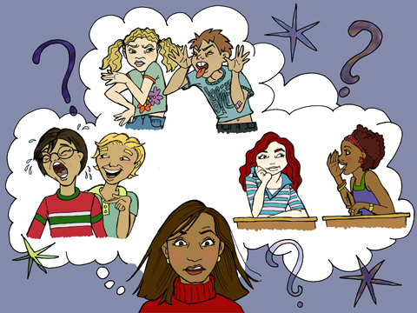
Page 1: Effects of Disruptive Behavior
Reflection Questions
How do you identify with the information in the “Research Shows” box?
Are discipline issues a primary concern for you?
Do or did you feel inadequately equipped to address disruptive behavior?
Notes:
Time: 10 minutes
Facilitator Notes:
Direct teachers to read through the content of Page 1 in the module.
Have teachers answer questions about their own preparation in behavior management in their Participants’ Guided Notes.

Slide 12

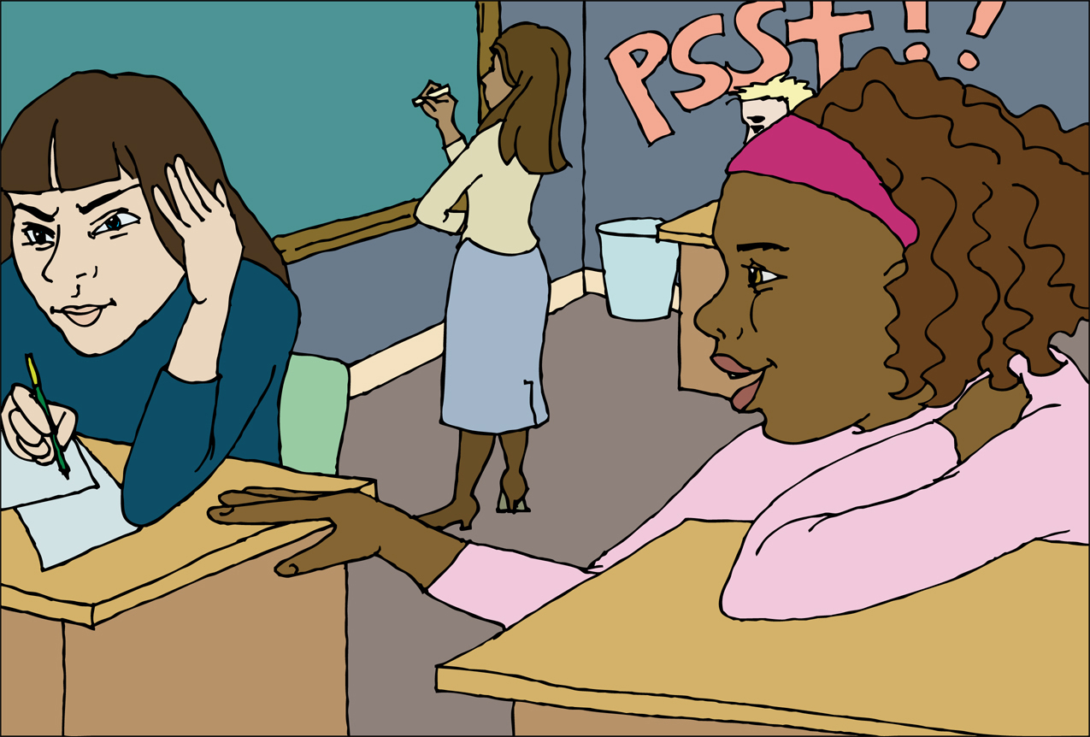
Page 1: Effects of Disruptive Behavior
After listening to Dr. Michael Rosenberg, reflect on and respond to the question:
How did you manage disruptive behavior on your first day or your WORST day of teaching?
Share your responses with your partner.
Surface Behaviors
List the surface behaviors that are most disruptive in your classroom.
How do these behaviors disrupt your classroom? What are your current solutions to these behaviors?
Notes:
Time: 25 minutes
Facilitator Notes:
Direct teachers to listen to the recording or read the transcript of Dr. Michael Rosenberg. (2 minutes)
Have teachers respond to the questions in their Participants’ Guided Notes. (5 minutes)
Partner Work: Have teachers share their responses about their most difficult days with their partners. (10 minutes)
Direct teachers to the section of the page referring to managing surface behaviors. (3 minutes)
Have teachers respond to the questions about surface behaviors in their Participants’ Guided Notes. (5 minutes)

Slide 13
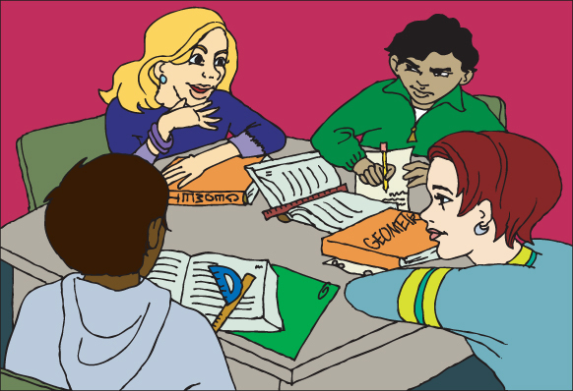
Page 2: Cultural Influences on Behavior
Think about each interaction style:
Degree of Directness
Level of Emotionality
Degree of Movement
Verbal Turn Taking
Expressions of Consideration
Attitudes Toward Personal Space
Attitudes Toward Sharing
Reflect on your own experiences and the frame of reference in relation to your own upbringing and school experience for each style discussed.
Notes:
Time: 20 minutes
Facilitator Notes:
Direct teachers to read through the content of Page 2 of the module to learn how different styles of interaction can influence behavior. Tell them to stop before they get to “Response to Authority Figures.” (10 minutes)
Have teachers reflect on their different styles of interaction based on their own upbringing and their own school experiences. (5 minutes)
Direct teachers to complete the table in their Participants’ Guided Notes reflecting on their own frame of reference in regard to behavior and the different styles of interaction discussed on Page 2. (5 minutes)

Slide 14
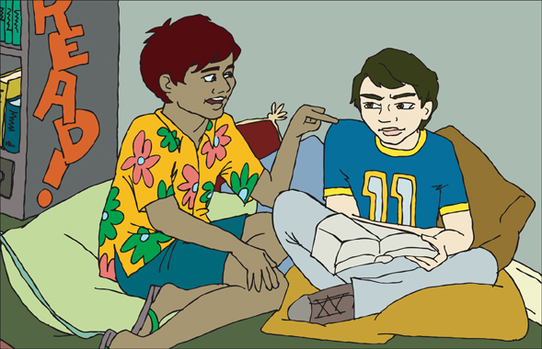
Page 2: Cultural Influences on Behavior
Reflection Questions
Do these situations differ from the styles of the students in your classroom?
What did you learn about the differences in your style of interaction compared to your students?
Were there many areas of congruence or difference?
How has culture shaped how you respond to authority figures?
Notes:
Time: 15 minutes
Facilitator Notes:
Direct teachers to reflect on what they learned by completing the table. Have them write their reflections in their Participants’ Guided Notes. (5 minutes)
Team Work: Have them share their reflections with their table group or team. (10 minutes)

Slide 15
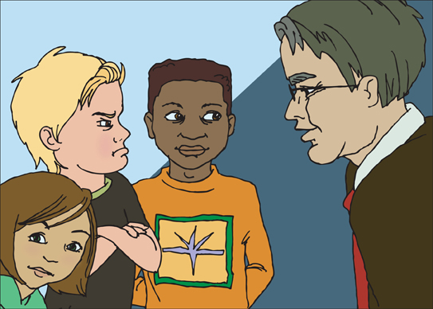
Page 2: Cultural Influences on Behavior
Respond to the questions regarding your perceptions of authority figures and the perceptions of your students in the areas of:
Perceptions of authority figures
Manner in which respect is shown
Recognizing cultural differences—becoming a student of your students
Notes:
Time: 15 minutes
Facilitator Notes:
Direct teachers to read the section on Page 2 about Response to Authority Figures and listen to the two experts or read the transcripts. Have them click on each title to learn more about the different cultural responses. (10 minutes)
Direct them to respond to the questions about how culture has shaped their own response to authority figures in their Participants’ Guided Notes. (5 minutes)

Slide 16

Page 2: Cultural Influences on Behavior
Based on the Cultural Responsiveness Assessment:
Think about what you can do to promote cultural responsiveness in your own teaching.
Write down a few ideas and share one idea with your partner.
Notes:
Time: 20 minutes
Facilitator Notes:
Direct teachers to the activity “Are You a Culturally Responsive Teacher?” at the bottom or Page 2. (10 minutes)
Once they have completed the activity, have them reflect on what they have learned about their own cultural sensitivity and write their responses in their Participants’ Guided Notes. (5 minutes)
Team Work: Have teachers write down a few ideas about how to become more culturally responsive. Have them share these ideas with their partner. (5 minutes)

Slide 17
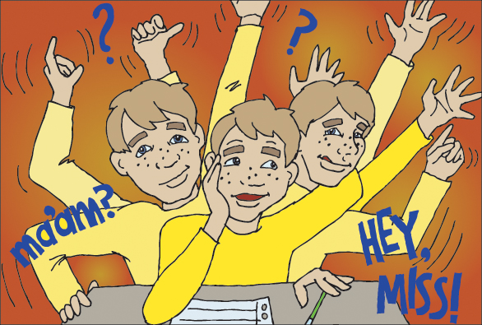
Page 3: Classroom and Teacher Influences on Behavior
Classroom factors that influence student behaviors include:
Classroom organization
Environment
Schedule
Transitions
Notes:
Time: 10 minutes
Facilitator Notes: Direct teachers to read through the first paragraph and three links on Page 3 to learn about classroom and teacher influences on behavior.

Slide 18
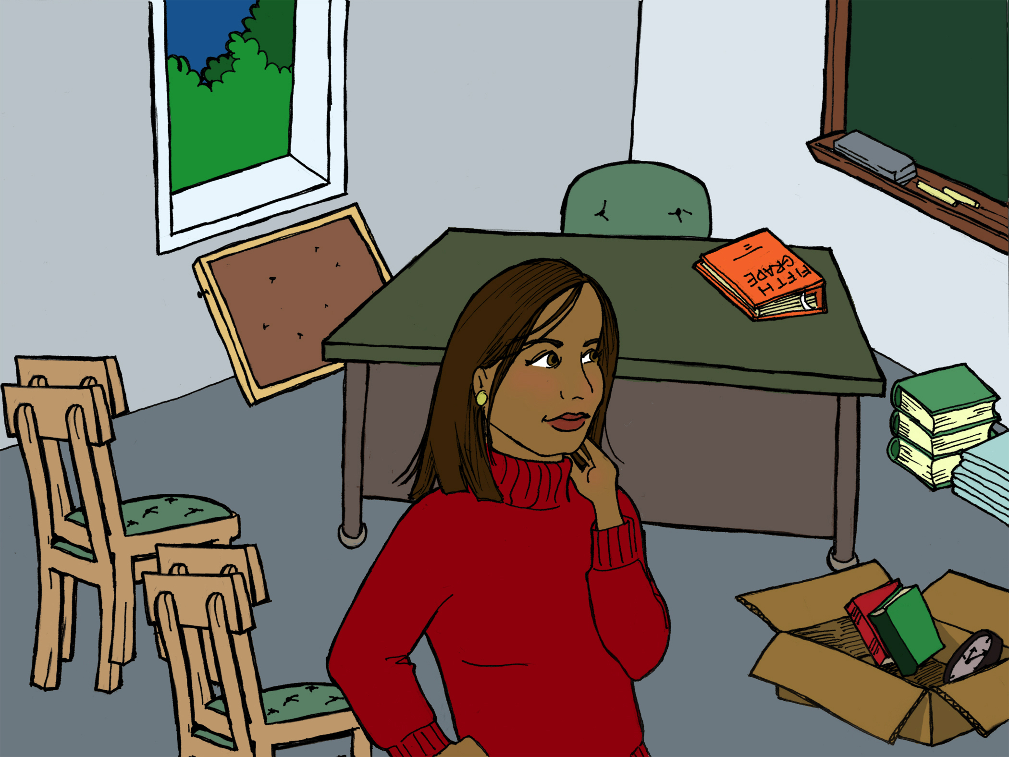
Page 3: Classroom and Teacher Influences on Behavior
Reflect on how your own practice might be influencing student behaviors in your classroom for each of these areas:
Organizing the classroom
Creating a daily schedule
Cueing transitions
Notes:
Time: 5 minutes
Facilitator Notes: Direct teachers to reflect on their own classroom practices in relation to organization, daily schedules, and transitions that might be affecting classroom behavior. Have them write their responses in their Participants’ Guided Notes.

Slide 19
Page 3: Classroom and Teacher Influences on Behavior
Surface Management Strategies
Identify the surface management strategies you currently use.
Identify one new surface management strategy you will try next week.
Share this strategy with your group.
Surface Management Strategies
Redirecting
Planned ignoring
Signaling
Proximity control
Interest boosting
Use of humor
Hurdle help
Removal of the object
Antiseptic bouncing
Notes:
Time: 25 minutes
Facilitator Notes:
Direct teachers to review the surface management strategies described on Page 3.
Direct them to listen to Dr. Michael Rosenberg and Dr. Lori Jackman as they discuss surface management strategies in greater detail. (10 minutes)
Have them review the list in their Participants’ Guided Notes and identify the surface management strategies they are currently using, and identify a new one they will try this week. (5 minutes)
Team Work: Have teachers share the new strategy with their group. (10 minutes)

Slide 20
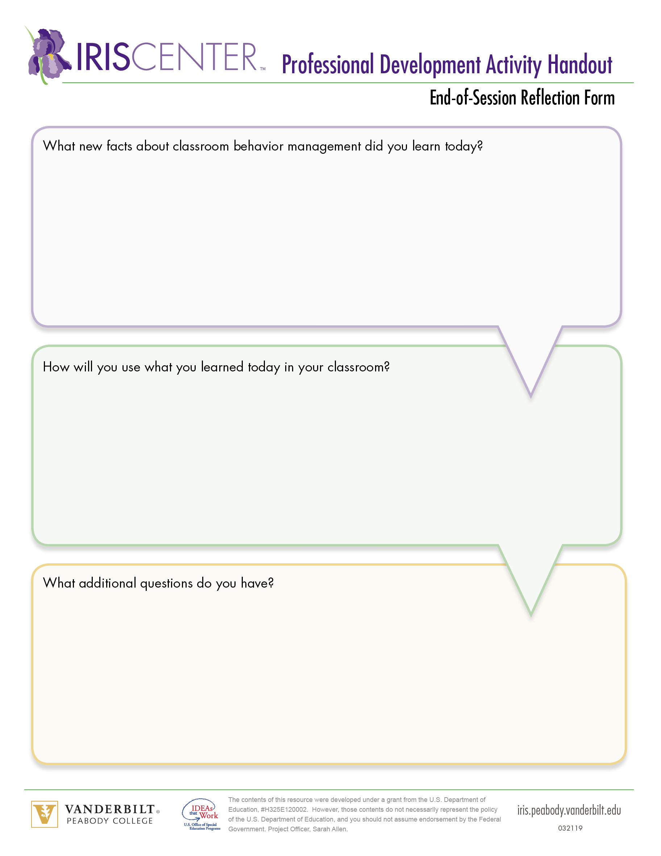
End-of-Session Reflection
Complete End-of-Session Reflection Form
Notes:
Facilitator Notes:
End of Session 1.
Remind participants to bring Participants’ Guided Notes to the next session.
Complete End-of-Session Reflection Form.

Slide 21

Page 4: Introduction to Comprehensive Behavior Management Plans
Ms. Rollison identifies the attributes of an effective behavior management system.
Notes:
Time: 1 minute
FYI:
After reviewing slides 1 and 7, begin Session 2.
Ask participants to use their Participants’ Guided Notes from the previous session.
Facilitator Notes: Direct teachers to read through the contents of Page 4 of the module to begin to learn the importance of seeing an effective behavior management plan as a system rather than a bag of tricks.

Slide 22

Page 4: Introduction to Comprehensive Behavior Management Plans
Six Key Principles for a Comprehensive Behavior Management Plan
Invest time at the front end
Teach well with quality instruction
Focus on positive behaviors
Provide supports
Be educative, not vindictive
Be persistent and consistent
Notes:
Time: 25 minutes
Facilitator Notes:
Direct teachers to read through “Six Key Principles” on Page 4.
Have them listen to Lauren Acevedo discuss the importance of developing a comprehensive behavior management plan before entering the classroom.
Tell them to stop there and write the key points for each component in their Participants’ Guided Notes.

Slide 23

Page 4: Introduction to Comprehensive Behavior Management Plans
How does a comprehensive behavior management plan fit with positive behavior intervention and supports (PBIS)?
Define these terms in your Participants’ Guided Notes:
PBIS
Tertiary intervention
Secondary intervention
Primary intervention
Notes:
Time: 8 minutes
Facilitator Notes:
Direct teachers to read about how the comprehensive behavior management plan fits with PBIS. Tell them NOT to listen to the audio clip with Dr. Michael Rosenberg yet. (3 minutes)
In order to gain a greater understanding of PBIS in relation to classroom management, have them define the terms in their Participants’ Guided Notes. (5 minutes)

Slide 24
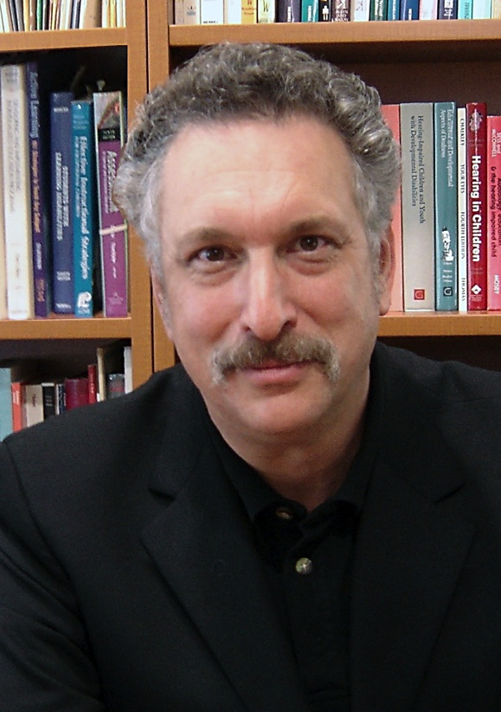
Page 4: Introduction to Comprehensive Behavior Management Plans
After listening to Dr. Michael Rosenberg, reflect and respond to the questions:
How does a comprehensive behavior management plan fit with a school-wide PBIS initiative?
Does your school currently have any of these supports? If so, which ones?
Notes:
Time: 10 minutes
Facilitator Notes:
Direct teachers to listen to Dr. Michael Rosenberg as he discusses how the classroom behavior management plan is considered a primary prevention. (2 minutes)
Have teachers respond to the questions reflecting current school-wide supports at their own school. (8 minutes)

Slide 25
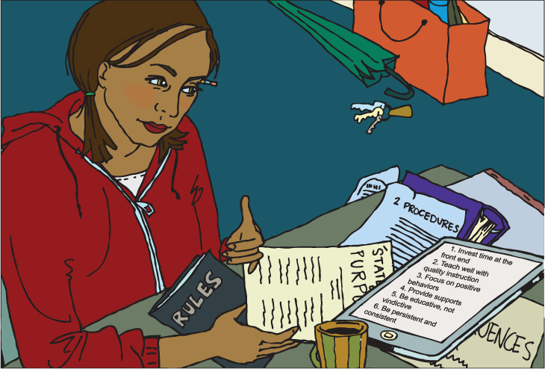
Page 5: Components of a Comprehensive
Behavior Management Plan
Ms. Rollison is following the first key principle of behavior management—invest time at the front end.
Notes:
Time: 5 minutes
Facilitator Notes: Direct teachers to read Page 5 of the module up to the “Research Shows” box (stop before that box). Have them focus on the first key principle of developing the comprehensive classroom plan, Invest time at the front end, as Ms. Rollison plans to make her behavioral expectations clear.

Slide 26

Page 5: Components of a Comprehensive
Behavior Management Plan
Teachers should invest time in thinking about how they expect students to behave. Write the key features of each of the five components of a comprehensive behavior management plan:
A statement of purpose
Rules
Procedures
Consequences
An action plan
Notes:
Time: 5 minutes
Facilitator Notes: Direct teachers to write the key features of communicating expectations in their Participants’ Guided Notes.

Slide 27
Page 5: Components of a Comprehensive
Behavior Management Plan
Evidence-based practices:
Maximize structure
Establish and teach rules
Actively engage students during instruction
Use a variety of strategies to respond to appropriate behaviors
Use a variety of strategies to respond to inappropriate behaviors
Discuss and share your practice with a colleague (give one) and then listen to the colleague share and discuss his or her practice with you (get one).
Notes:
Time: 15 minutes
Facilitator Notes:
Direct teachers to read through the research-based classroom management practices identified in the “Research Shows” box. (Read that box only!) Have them write one example of their current practice in each of the five areas in the table in their Participants’ Guided Notes. (5 minutes)
Team Work (“Give One-Get One”): Have teachers write one of the practices they use on a sticky note and find a colleague with whom to share their practice. After giving the sticky note with the explanation, the other teacher shares their practice and gives their sticky note to their partner. (10 minutes)

Slide 28
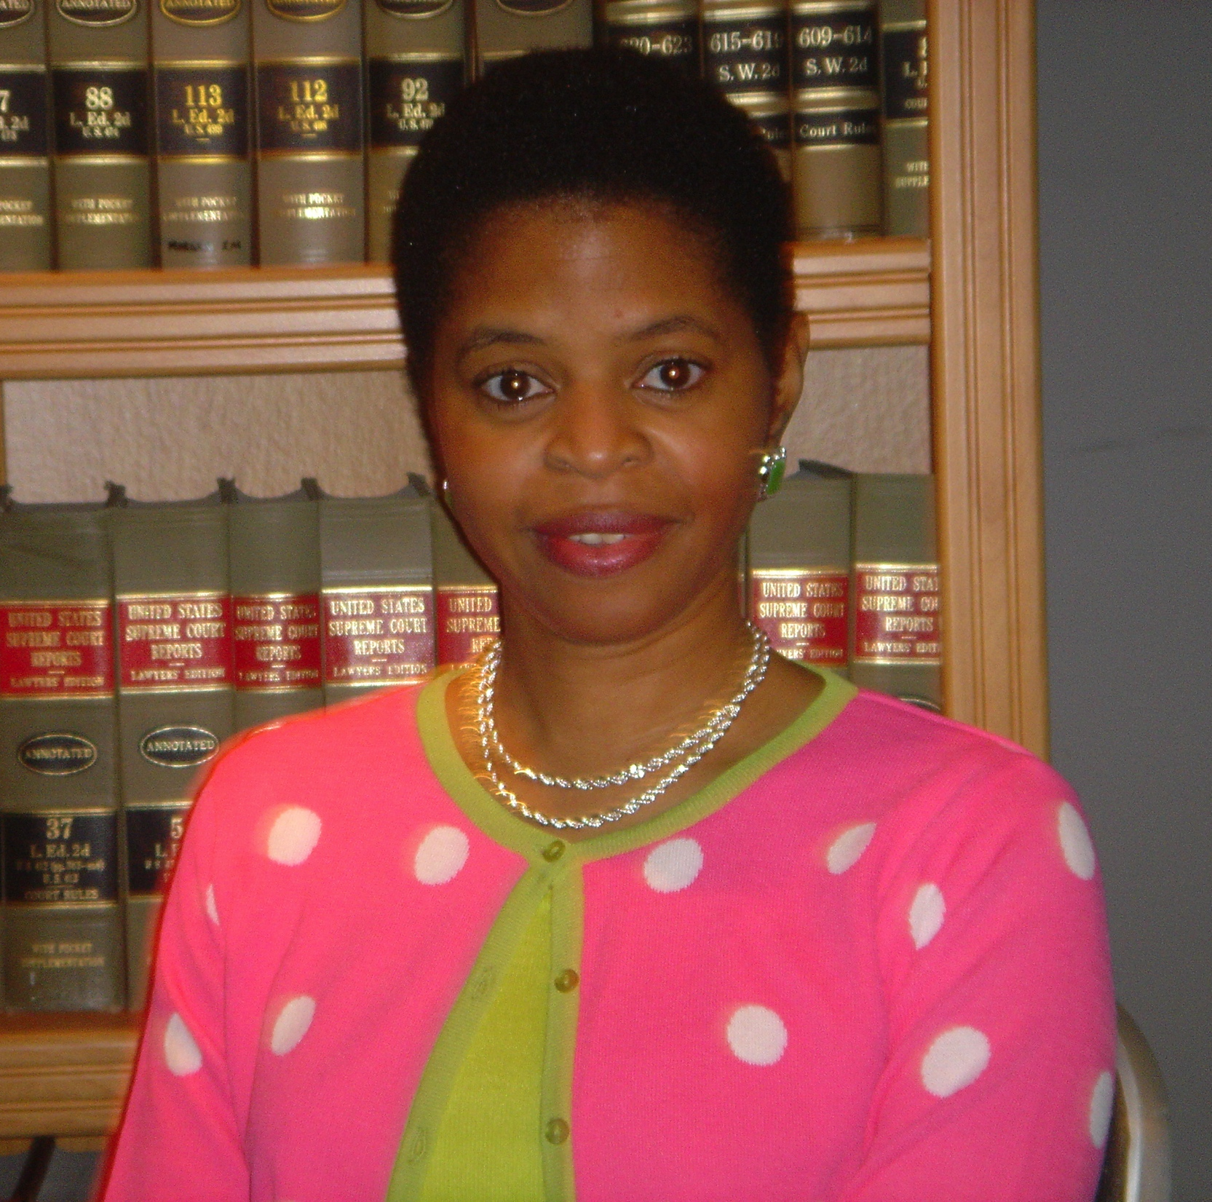
Page 5: Components of a Comprehensive
Behavior Management Plan
After listening to Dr. Deborah Voltz, discuss the following questions with your partner:
How do we lose students’ confidence when we inconsistently enforce behavioral expectations?
Why?
Notes:
Time: 10 minutes
Facilitator Notes:
Direct teachers to read the rest of Page 5 and listen to Dr. Deborah Voltz and Lauren Acevedo discuss discuss how management styles differ in different cultures.
After listening, direct teachers to respond to the question associated with Dr. Voltz’s discussion of students feeling secure in a classroom with consistent behavior management and enforcement in their Participants’ Guided Notes.

Slide 29
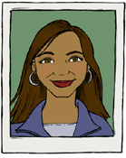
Page 6: Statement of Purpose
Ms. Rollison learns that she must start with a statement of purpose—a brief, positive statement that conveys to parents and students the reasons why various aspects of the management plan are necessary.
Notes:
Time: 5 minutes
Facilitator Notes: Direct teachers to read through the contents of Page 6 of the module up to the Dr. Rosenberg audio clip to learn about the importance of building the classroom behavior management plan with a clear statement of purpose.

Slide 30
Page 6: Statement of Purpose
Statement of purpose criteria:
Focused
Direct
Clearly understood
Free of teacher jargon
Sample Statement of Purpose
Our classroom will be a positive, considerate learning environment that fosters academic excellence and respect for others. All students will strive to do their best, both academically and behaviorally, to promote the success of everyone in the classroom.
Write down the key points for each component of a statement of purpose.
Notes:
Time: 5 minutes
Facilitator Notes: Direct teachers to review the statement of purpose criteria, writing the key points for each in their Participants’ Guided Notes.

Slide 31
Page 6: Statement of Purpose
After listening to Dr. Michael Rosenberg, reflect and respond to the following question:
How is the statement of purpose the foundation of the comprehensive behavior management plan?
Share your responses with your partner.
Notes:
Time: 10 minutes
Facilitator Notes:
Direct teachers to listen to Dr. Michael Rosenberg discuss the importance of having a statement of purpose and read the last paragraph leading up to the activity.
Have them respond to the question in their Participants’ Guided Notes. (5 minutes)
Team Work: Have teachers share their responses about the statement of purpose with their partners. (5 minutes)

Slide 32
Page 6: Statement of Purpose
Statement of Purpose
In our classroom, we have high expectations for our students, all of whom are valued as learners and productive thinkers. We recognize individual differences and respect cultural diversity. We are committed to enhancing student achievement and to helping students develop an internal locus of control and self-determined behavior, to providing a safe and nurturing instructional environment, to working with parents as partners in the education of all children, and to engaging children in cooperative problem solving.
Activity: Review Ms. Rollison’s statement of purpose.
Complete the activity by clicking a green or red checkmark.
Work together to rewrite Ms. Rollison’s statement of purpose to fully meet the criteria.
Notes:
Time: 15 minutes
Facilitator Notes:
Direct teachers to complete the activity to review Ms. Rollison’s statement of purpose found on Page 6 and in the Participants’ Guided Notes. (5 minutes)
Team Work: Have teachers or teams review her statement of purpose using the criteria described, clicking on green if it has met the criteria or red if it has not.
Once teams have completed the activity, have them review the feedback and rewrite Ms. Rollison’s statement of purpose. They can write a draft in their Participants’ Guided Notes or write it directly into the text field on Page 6. (10 minutes)

Slide 33
Page 7: Rules
Ms. Rollison thinks about her expectations for her students, the behaviors she wants them to display. From these she will develop a set of classroom rules.
Notes:
Time: 15 minutes
Facilitator Notes: Direct teachers to read through the contents of Page 7 of the module up to the activity to learn more about rules and their role in a comprehensive classroom behavior management plan.

Slide 34

Page 7: Rules
Classroom rules reflect the classroom behavioral expectations. Think about your own classroom rules. Do they meet the described criteria?
Stated positively
Simple, specific terms
Measurable and observable
Convey the expected behavior
Notes:
Time: 5 minutes
Facilitator Notes: Direct teachers to think about their own classroom rules and to check the criteria their rules have met in their Participants’ Guided Notes.

Slide 35
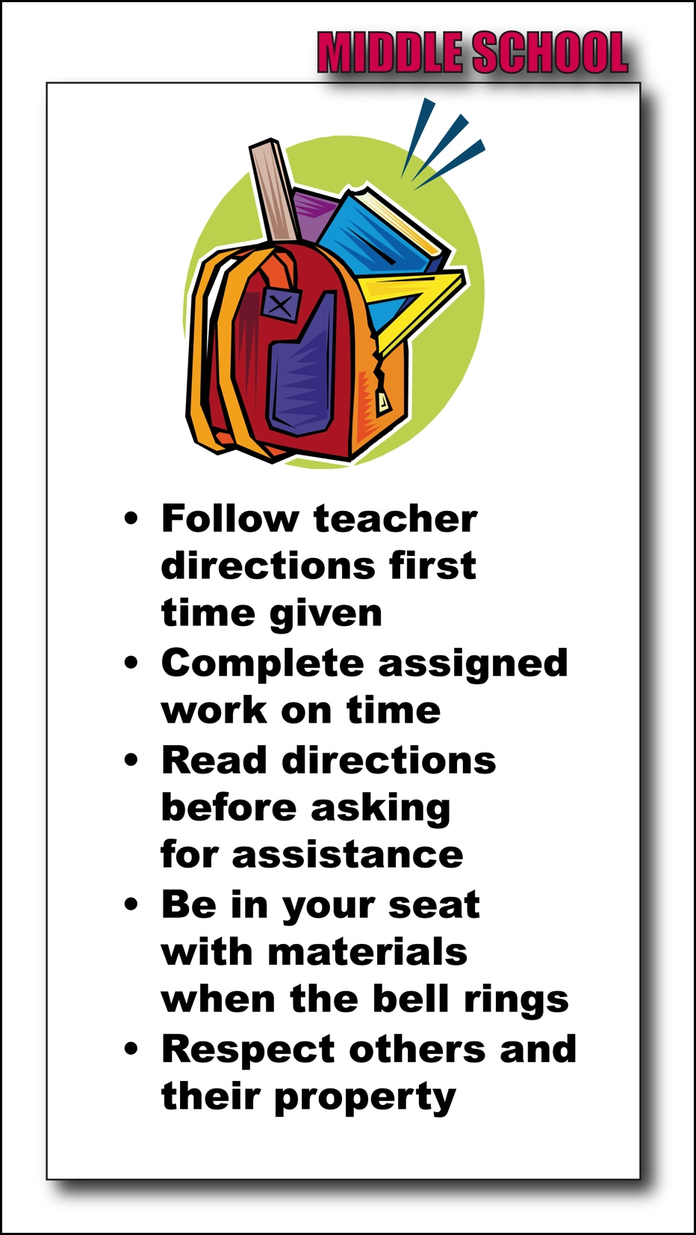
Page 7: Rules
Review the set of rules for your grade level.
How do your rules differ from these examples?
How are they the same?
What changes might you need to make for you or your grade level’s rules?
Notes:
Time: 10 minutes
Facilitator Notes:
Direct teachers to review the set of rules for their particular grade level.
Team Work: Have teams discuss how their own rules are the same or different than the ones they reviewed. Have them reflect on what changes they might need to make to their own rules and write these in their Participants’ Guided Notes.

Slide 36
Page 7: Rules
Ms. Rollison’s Rules
No running in class.
Follow all directions.
Fighting is forbidden.
Speak respectfully and use an “inside voice.”
Do your best work.
Ms. Rollison’s Rules and Expectations
Discuss with your group:
    Are the rules aligned with her expectations?
    Do they follow the guidelines?
    Do they cover the behaviors she wanted addressed?
Check to see whether your thoughts and reflections were on track.
What did you learn from this activity?
Notes:
Time: 20 minutes
Facilitator Notes:
Team Work: Conduct the activity. Direct teachers to review what Ms. Rollison wants her rules to convey and to check to see whether her rules actually align with her expectations. (5 minutes)
Have teams discuss their thoughts on Ms. Rollison’s rules and determine whether they followed the guidelines and whether they covered the behaviors she wanted addressed.
Direct them to view the feedback on Ms. Rollison’s rules on the bottom of the page and check to see whether their responses were similar to the ones on Page 7.
Have the teachers reflect on what they learned from this activity. Do their own rules actually address the behaviors that they expect? (15 minutes)

Slide 37
End-of-Session Reflection
Complete End-of-Session Reflection Form
Notes:
Facilitator Notes:
End of Session 2.
Remind participants to bring Participants’ Guided Notes to the next session.
Complete End-of-Session Reflection Form.

Slide 38
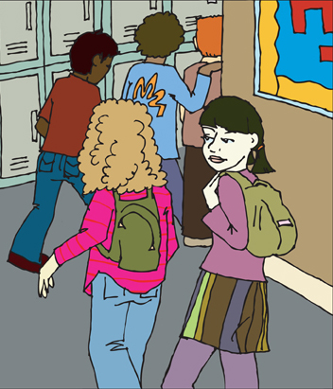
Page 8: Procedures
Procedures describe the steps required for students to successfully complete daily routines and less frequent activities.
Notes:
Time: 10 minutes
FYI:
After reviewing slides 1 and 7, begin Session 3.
Ask participants to use their Participants’ Guided Notes from the previous session.
Facilitator Notes: Direct teachers to read through the contents of Page 8 of the module. Have them listen to the two audio clips to learn more about the role of procedures in ensuring the students are able to successfully complete the activities for each day (stop at the activity).

Slide 39
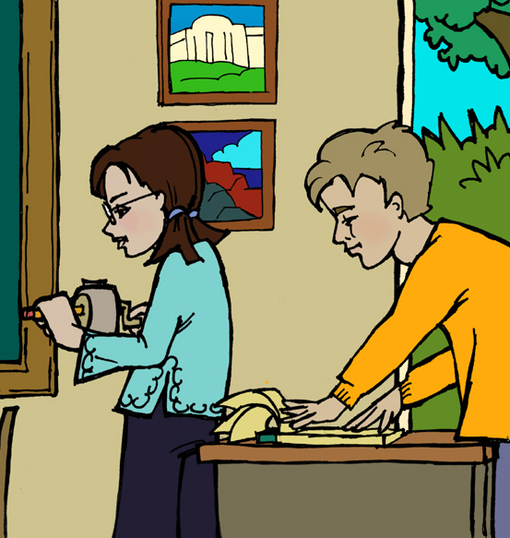
Page 8: Procedures
Reflection and Sharing
Discuss how procedures describe the steps required for students to successfully complete daily routines.
What are some of the benefits to teaching specific classroom procedures?
Share with your partner.
Notes:
Time: 15 minutes
Facilitator Notes:
Direct teachers to discuss the importance of procedures in the classroom.
Team Work: Have teachers respond to the question about the benefits of procedures in their Participants’ Guided Notes, and then share their responses with their partners.

Slide 40
Page 8: Procedures
Review key considerations for developing effective procedures.
Walking in the Hallway
Single file
Straight line
Silent
Stop at checkpoints
Why is the procedure needed?
Where is the procedure needed?
What does the procedure entail?
Who will use the procedure?
When is the procedure needed?
How should the procedure be implemented?
Notes:
Time: 5 minutes
Facilitator Notes: Direct teachers to review the key considerations of effective procedures and write the main points for each in their Participants’ Guided Notes.

Slide 41
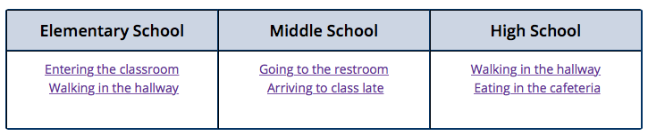
Page 8: Procedures
Time to Practice
Review one of the sample procedures for your grade level.
With your grade-level team or group, develop a procedure for a common transition activity such as entering the room or walking in the hallway.
Notes:
Time: 15 minutes
Facilitator Notes:
Team Work: Direct teachers to review one of the sample procedures for their grade level. Then have the team develop its own procedure for a common transition activity such as entering the room or walking in the hallway.
Have them record the new procedure in their Participants’ Guided Notes.

Slide 42
Page 8: Procedures
Ms. Rollison has developed a number of procedures.
As a group or team, help Ms. Rollison develop another classroom procedure.
Once done, click to evaluate the procedure your group or team has developed.
Notes:
Time: 15 minutes
Facilitator Notes:
Team Work: In the activity at the bottom of the page, Ms. Rollison has developed procedures for going to the restroom, entering the classroom, walking in the hallway, and arriving late to class. Direct teachers to think of another classroom procedure that Ms. Rollison might need and write it down in their Participants’ Guided Notes. Once they have completed the procedure, have them evaluate it by clicking on the evaluation link on the bottom of Page 8.

Slide 43
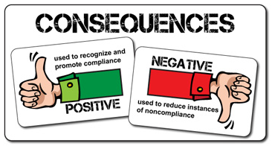
Page 9: Consequences: An Introduction
Consequences, both positive and negative, prepare the teacher to respond to behaviors and allow students to know what to expect.
Notes:
Time: 5 minutes
Facilitator Notes: Direct teachers to read through the contents of Page 9 of the module to learn more about the importance of consequences in letting students know what to expect.

Slide 44
Page 9: Consequences: An Introduction
Do your own consequences meet the criteria?
Are they clear and specific?
Do they relate directly to the rules and procedures?
Are they responsive to a range of intensity or hierarchy of alternatives?
Are they natural and logical for the school’s environment?
Discuss with your partner whether your current consequences are natural and logical.
Notes:
Time: 20 minutes
Facilitator Notes:
Direct teachers to think about their own classrooms and the consequences they are currently using. Have them reflect on these and use the checklist in their Participants’ Guided Notes to determine whether they meet the criteria described.
Have them write their reflections on how their consequences are natural and logical. (10 minutes)
Team Work: Have teachers share how their consequences are or are not natural and logical with their partners. (10 minutes)

Slide 45

Page 10: Positive Consequences
A positive consequence, or reinforcement, is a means by which teachers can increase the probability that a behavior will occur again in the future.
Notes:
Time: 5 minutes
Facilitator Notes: Direct teachers to read through the contents of Page 11 of the module up to “Delivering Consequences” to learn more about the purpose of positive reinforcers in increasing the probability of a behavior occurring again.

Slide 46
Page 10: Positive Consequences
Review your own positive reinforcers. Are they:
Something the student considers pleasant or rewarding?
Inexpensive?
Appropriate to the classroom environment?
Easily and quickly administered or awarded?
Do they meet the criteria?
Notes:
Time: 5 minutes
Facilitator Notes:
Direct teachers to think about the positive reinforcers they currently use in their classrooms.
Have them check the criteria those reinforcers meet and record their answers in their Participants’ Guided Notes.

Slide 47
Page 10: Positive Consequences
Characteristics of Positive Consequences
Review the table of tangible, social, and activity reinforcers.
Share any additional reinforcer you may use with your group or team.
Tangible | Social | Activity
Stickers Tokens | Smile Praise | Reading a story Drawing
Notes:
Time: 15 minutes
Facilitator Notes:
Direct teachers to review the list of common reinforcers on Page 10. (5 minutes)
Have them add a few more to each list in the table in their Participants’ Guided Notes. (5 minutes)
Team Work: Have teachers share what they have added to their list with their group or team. (5 minutes)

Slide 48
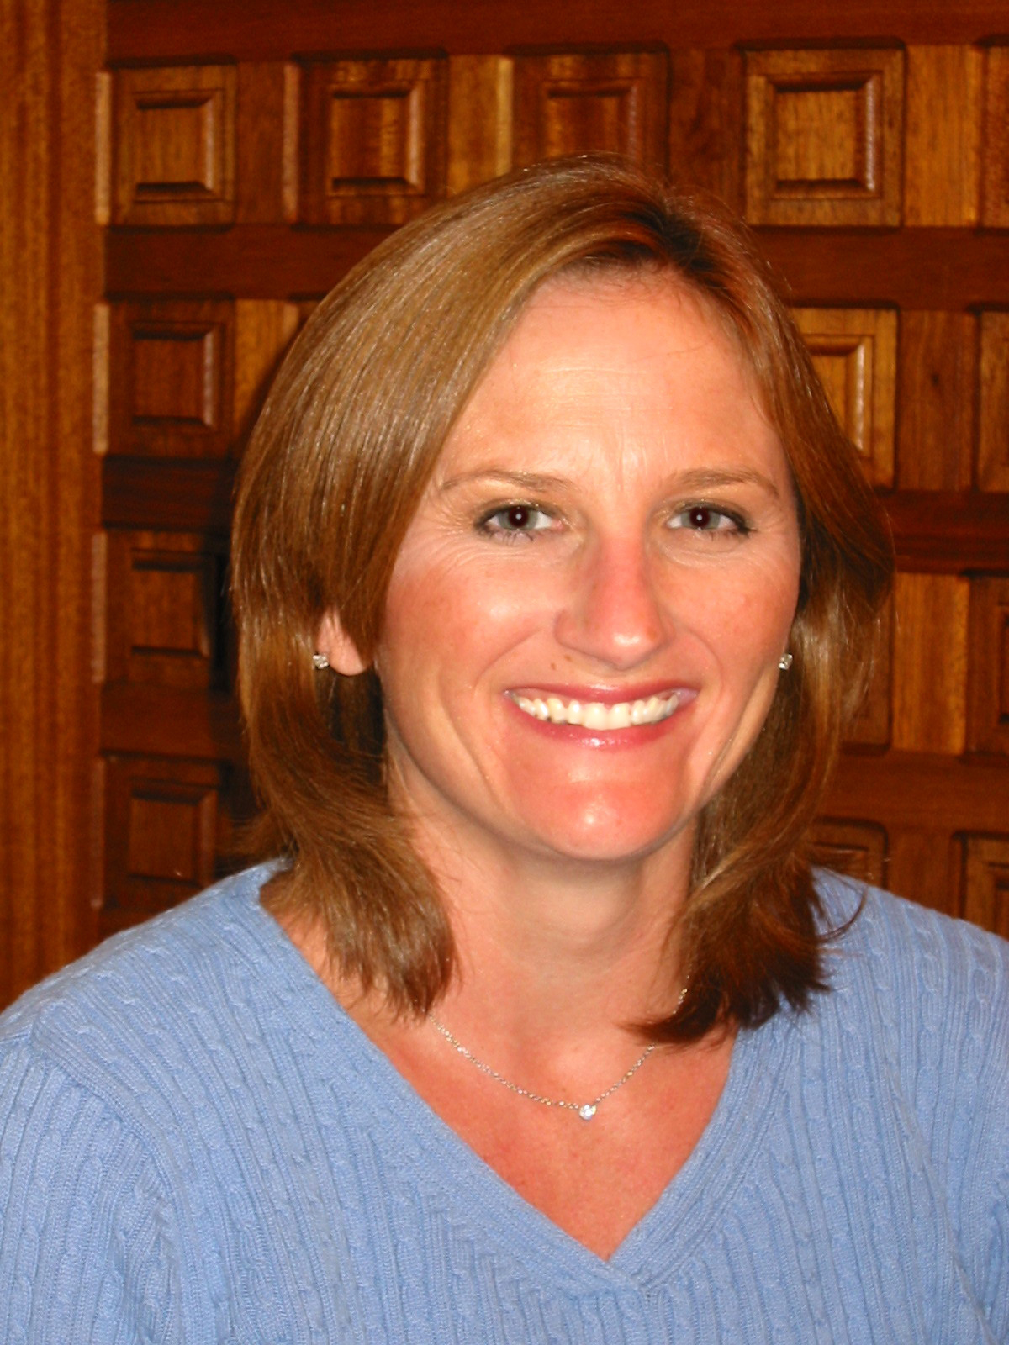
Page 10: Positive Consequences
After listening to Dr. Lori Jackman, reflect and respond to the following question:
Why is it important to be “heavy handed” when you begin implementing a behavior management system?
Notes:
Time: 10 minutes
Facilitator Notes:
Direct teachers to read about delivering consequences and listen to Dr. Lori Jackman as she discusses steps to beginning to implement a comprehensive behavior management plan and the role of positive reinforcers.
Direct teachers to reflect and respond to the question, jotting down their ideas in their Participants’ Guided Notes.

Slide 49
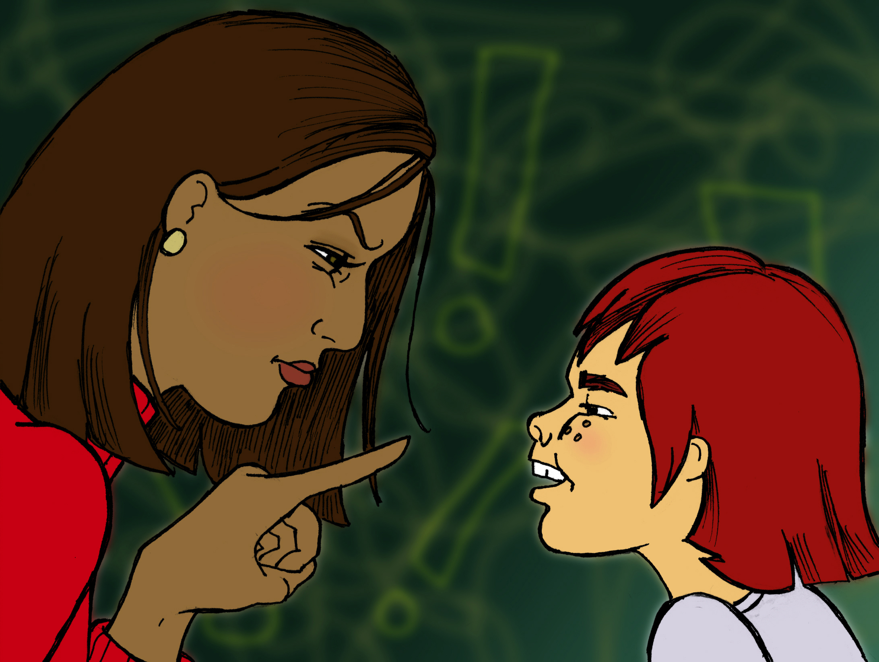
Page 11: Negative Consequences
Negative consequences are the means by which teachers can decrease the probability that a behavior will occur in the future.
Notes:
Time: 5 minutes
Facilitator Notes: Direct teachers to read through the contents of Page 11 of the module up to “Delivering Consequences” to learn more about the purpose of negative consequences in decreasing the probability that a behavior will occur in the future.

Slide 50
Page 11: Negative Consequences
Evaluate your own negative consequences. Are they:
Considered unpleasant by students?
Applied in an educative rather than vindictive fashion?
Administered calmly and consistently?
Applied along with positive consequences?
Logical for the undesirable behavior?
Applied immediately after the behavior occurs?
Considerate of a student’s dignity?
Notes:
Time: 5 minutes
Facilitator Notes:
Direct teachers to review the criteria for negative consequences on Page 11 and in their Participants’ Guided Notes.
Have them think about the negative consequences they currently use and determine whether those meet the criteria described.
Have them check the ones that are congruent with their current negative consequences.

Slide 51
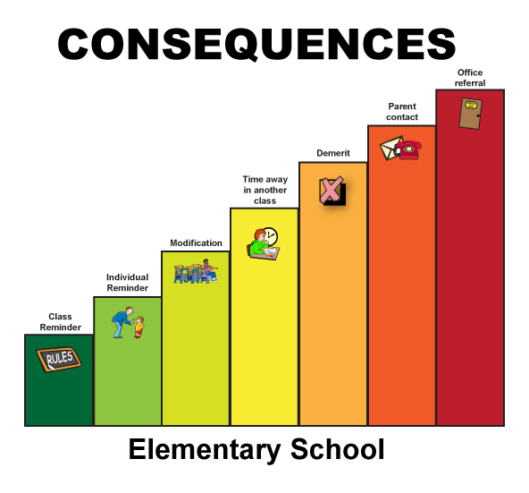
Page 11: Negative Consequences
Activity
Review the negative consequence hierarchies for your grade level.
Are your negative consequences organized in an increasing intensity hierarchy?
If not, how would they need to be changed?
Notes:
Time: 10 minutes
Facilitator Notes: Team Work: Direct teachers to review the examples of negative consequence hierarchies for their grade level on Page 11. Have them think about and discuss their own negative consequences and determine whether they are organized in an increasing hierarchy of intensity. Have them reflect as a team on what might need to be changed and jot down their ideas in their Participants’ Guided Notes.

Slide 52
Page 11: Negative Consequences
Deliver consequences with certainty:
Apply them consistently
Use the power of proximity
Make direct eye contact
Use a soft voice
Be firm and anger-free
Link the consequence to the expected behaviors
Never accept excuses, bargaining, or whining
Which of these is the most difficult for you? Share with your partner.
Notes:
Time: 15 minutes
Facilitator Notes:
Direct teachers to read “Delivering Consequences” to review the importance of how consequences are delivered and listen to Dr. Lori Jackman. Have them review the list that summarizes the best way to deliver consequences on Page 11 and write these in their Participants’ Guided Notes. Have them reflect on which one of these “deliveries” is the most difficult for them. (5 minutes)
Team Work: After reviewing the list of ways negative consequences should be delivered, have teachers share with their partners the one that is most difficult for them to do with certainty. (10 minutes)

Slide 53
Page 11: Negative Consequences
After listening to Dr. Lori Jackman, discuss these questions with your group or team:
Why is consistency important?
How do you ensure that students make the connection between negative consequences and the classroom behavior management system rather than the teacher?
Notes:
Time: 10 minutes
Facilitator Notes: Team Work: Have teams discuss why this consistency is so important to ensure that students make the connection between negative consequences and the classroom behavior management system and not the teacher. They can write their reflections in their Participants’ Guided Notes.

Slide 54
End-of-Session Reflection
Complete End-of-Session Reflection Form
Notes:
Facilitator Notes:
End of Session 3.
Remind participants to bring Participants’ Guided Notes to the next session.
Complete End-of-Session Reflection Form.

Slide 55
Page 12: Action Plan
Ms. Rollison is ready to develop her action plan to implement her classroom management system.
Notes:
Time: 10 minutes
FYI:
After reviewing slides 1 and 7, begin Session 4.
Ask participants to use their Participants’ Guided Notes from the previous session.
Facilitator Notes: Direct teachers to read through the content of Page 12 of the module to learn more about how Ms. Rollison will develop her action plan for implementing her classroom behavior management system.

Slide 56
Page 12: Action Plan
In order to implement her plan, Ms. Rollison needs to follow several steps:
1) Develop a toolkit
2) Teach the plan to her students
3) Share the plan with others
4) Review the plan regularly
Notes:
Time: 10 minutes
Facilitator Notes:
Direct teachers to review the action plan steps described on Page 12.
Team Work: As teams reflect on what they have learned in this PD series, have them work together with a partner or in a school team to begin developing an action plan that incorporates the four tasks of the action planning process.

Slide 57

Page 12: Action Plan
Work with your group or team to identify steps to develop your own comprehensive behavior management plan.
Develop a Toolkit
Teach the Plan
Share the Plan
Review the Plan
Notes:
Time: 40 minutes
Facilitator Notes: Team Work: Direct teaching teams to work together to brainstorm ideas for possible steps for each area. Direct them to review the steps that Ms. Rollison has developed for her action plan on Page 12 and begin to add to the chart in their Participants’ Guided Notes.
FYI: If teams need more scaffolding, use the following slides to break the tasks into smaller parts. (10 minutes for each section)

Slide 58

Page 12: Action Plan
Develop a Toolkit
Objectives
How it will be accomplished
Completion date
Develop a toolkit: all of the forms, posters, and supports necessary to
Implement and sustain the plan
Notes:
Time: 10 minutes
FYI: This is an optional slide.
Facilitator Notes: Team Work: Direct teams to identify the objective, how the task will be accomplished, and a completion date for each activity related to “develop a toolkit.”

Slide 59

Page 12: Action Plan
Teach the Plan
Objectives
How it will be accomplished
Completion date
Teach the plan to the students
Notes:
Time: 10 minutes
FYI: This is an optional slide.
Facilitator Notes: Team Work: Direct teams to identify the objective, how the task will be accomplished, and a completion date for each activity related to “teach the plan.”

Slide 60
Page 12: Action Plan
Share the Plan
Objectives
Implementation plan
Completion date
Share the plan with others
(e.g., administration, parents, and substitute teachers)
Notes:
Time: 10 minutes
FYI: This is an optional slide.
Facilitator Notes: Team Work: Direct teams to identify and set the objectives, how the task will be accomplished, and the completion date for each activity related to “share the plan.”

Slide 61

Page 12: Action Plan
Review the Plan
Objectives
Implementation plan
Completion date
Review the plan regularly
Notes:
Time: 10 minutes
FYI: This is an optional slide
Facilitator Notes: Team Work: Direct teams to analyze and review the objectives, how the task will be accomplished, and the completion date for each activity related to “review the plan.”
.

Slide 62
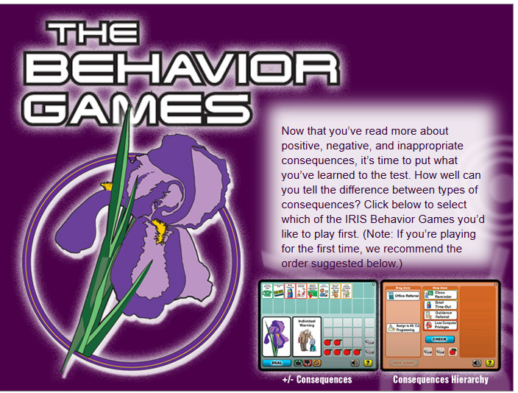
Page 13: Practice with the Components
Practice
Positive and negative consequences
Consequences hierarchy
Notes:
Time: 20 minutes
Facilitator Notes:
Direct teachers to the games on Page 13 of the Module to practice what they have learned about positive, negative, and inappropriate consequences.
Direct teachers to work individually or with a partner to complete the games. Once they have done so, have them reflect on their learning and development or refinement of their own classroom positive and negative consequences in their Participants’ Guided Notes.

Slide 63
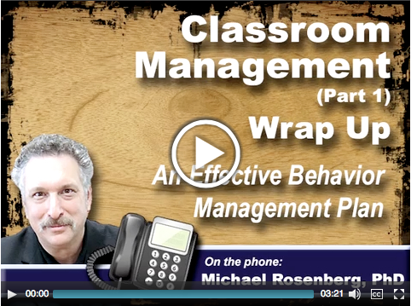
Wrap Up
Listen as Dr. Michael Rosenberg summarizes the components of a comprehensive behavior management plan.
Notes:
Time: 5 minutes
Facilitator Notes: Direct teachers to move to the Wrap Up section of the module and listen to Dr. Michael Rosenberg as he summarizes the components of a comprehensive behavior management plan.

Slide 64
Wrap Up
Revisiting Initial Thoughts
Do you still agree with your Initial Thoughts?
  What does Ms. Rollison need to understand about student behavior?
  What can Ms. Rollison do to increase the chances that her students will behave appropriately in class?
Discuss with your team any changes in your thoughts.
Notes:
Time: 10 minutes
Facilitator Notes:
Direct teachers to “Revisiting of Initial Thoughts” at the bottom of the Wrap Up page.
Have them reflect on their initial responses recorded in their Participants’ Guided Notes and determine whether they still agree with those Initial Thoughts or whether they would now change their answers.
Ask them to respond to the questions in the “Revisiting of Initial Thoughts” section in their Participants’ Guided Notes and reflect on how their answers may have changed.
Team Work: Discuss with your team any aspects of your Initial Thoughts that have changed.

Slide 65
Assessment
Complete the Assessment independently or in collaboration with your grade-level or content-area team.
Notes:
Time: Time may vary: approximately 30-40 minutes with 20 minutes for questions 1-3 and 20 minutes for questions 4 or 5.
Facilitators Notes:
Direct teams to move to the Assessment pages of both the module and their Participants’ Guided Notes. Complete questions 1, 2, and 3 either independently or with a partner.
Team Work: Have teams choose either question 4 or 5 and complete the tasks described.
FYI: The facilitator decides how these activities are to be completed, recorded, and collected.

Slide 66

End-of-Course Survey
Please provide your feedback on the content of this Module at:
http://iris.peabody.vanderbilt.edu/mcontent/iris_feedback/?PATH=beh1
Notes:
Time: 3 minutes
Facilitator Notes: Direct participants to complete the Module Feedback Form at the link provided before moving on to discuss Next Steps.

Slide 67
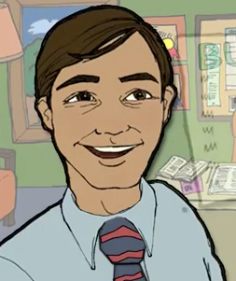
Next Steps
To refine the skills you developed during these trainings, review the second part of this IRIS Module series at http://
http://iris.peabody.vanderbilt.edu/module/beh2/module/beh2/
Classroom Management (Part 2): Developing Your Own Comprehensive Behavior Management Plan
This Module—a revision of You're in Charge! Developing Your Own Comprehensive Behavior Management Plan—reviews the major components of classroom management (including rules, procedures, and consequences) and guides users through the steps of creating their own comprehensive behavior plan.
Notes:
Time: 5 minutes
Facilitator Notes: Direct teachers to the second part of this training, which can be accessed at the IRIS Center Website link on the slide. The second part of the training is provided online only, and teachers can work on it independently at their own pace. In Part 2, the module guides users to develop an actual comprehensive behavior management plan, which becomes a living document for use across the school year.

Slide 68
End-of-Session Reflection
Complete End-of-Session Reflection Form
Notes:
FYI:
End of Session 4.
Complete End-of-Session Reflection Form.

