Slide 1

Professional Development Activity
Differentiated Instruction:
Maximizing the Learning of All Students
The IRIS Center is funded through a cooperative agreement U.S. Department of Education, Office of Special Education Programs (OSEP) Grant #H325E120002. The contents of this presentation do not necessarily represent the policy of the U.S. Department of Education, and you should not assume endorsement by the Federal Government. Project Officer, Sarah Allen.

Slide 2

Preparing for the Session
Please complete the following:
Sign in
Check your Internet connection
Locate the IRIS Website (iris.peabody.vanderbilt.edu or iriscenter.com)
Bookmark the IRIS Module Differentiated Instruction: Maximizing the Learning of All Students (http://iris.peabody.vanderbilt.edu/module/di/)

Slide 3
Challenge & Initial Thoughts
Independently answer the questions on your Initial Thoughts Handout.
Initial Thoughts Questions
What is differentiated instruction?
How do teachers differentiate instruction?
How do teachers prepare their students and their classrooms for differentiated instruction?
What does differentiated instruction look like in the classroom?
Notes:
As a whole group, view the Challenge video.

Slide 4
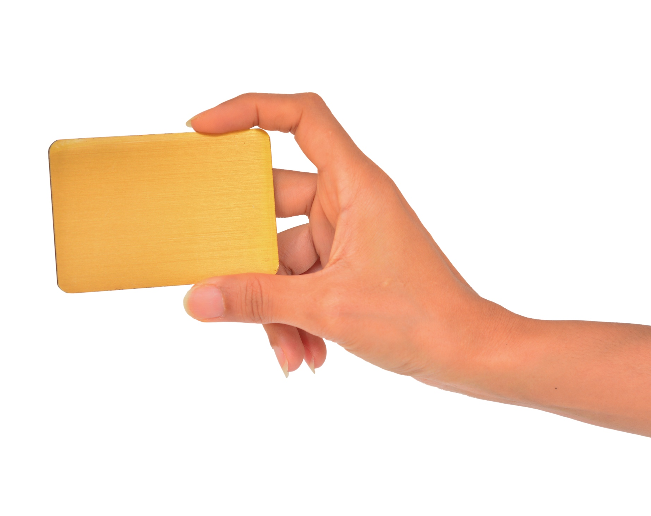
Familiarity Activity
For each of the statements that is read, hold up one of three cards to reflect your level of familiarity with it:
Color 1: Not familiar
Color 2: Somewhat familiar
Color 3: Very familiar
Notes:
Replace “Color 1,” “Color 2,” and “Color 3” with the color you have chosen to represent each level of familiarity.

Slide 5
Statements About Differentiated Instruction
Differentiated instruction (DI) is an approach whereby teachers adjust their curriculum and instruction to maximize the learning of all students.
Carol Ann Tomlinson is a key researcher and advocate for DI.
A teacher gradually shifts into providing a DI classroom environment.
The three main elements of instruction in a differentiated classroom are content, process, and product.
The principles of ongoing assessment and flexible grouping are key for DI.

Slide 6
Statements About Differentiated Instruction
When teachers employ DI, they need to communicate with parents and students how their instruction may differ from traditional methods.
A teacher using DI will consider students’ readiness levels, interests, and learning profiles helpful.
DI can enable a teacher to simultaneously meet the different learning needs of every student, those who struggle and those who do not.
Teachers who use DI are able to assess/grade accurately and fairly those students who perform at varying levels of proficiency.
In a differentiated classroom, the organization and structure of the physical and social space of the classroom makes a difference to the teacher and students.

Slide 7
Familiarity Activity Answers
Statement | Location of Content
1 | Page 1
2 | Page 1
3 | Page 12
4 | Page 4
5 | Page 2
6 | Page 9
7 | Page 3
8 | Pages 5, 6, and 7
9 | Page 8
10 | Pages 10 and 11

Slide 8
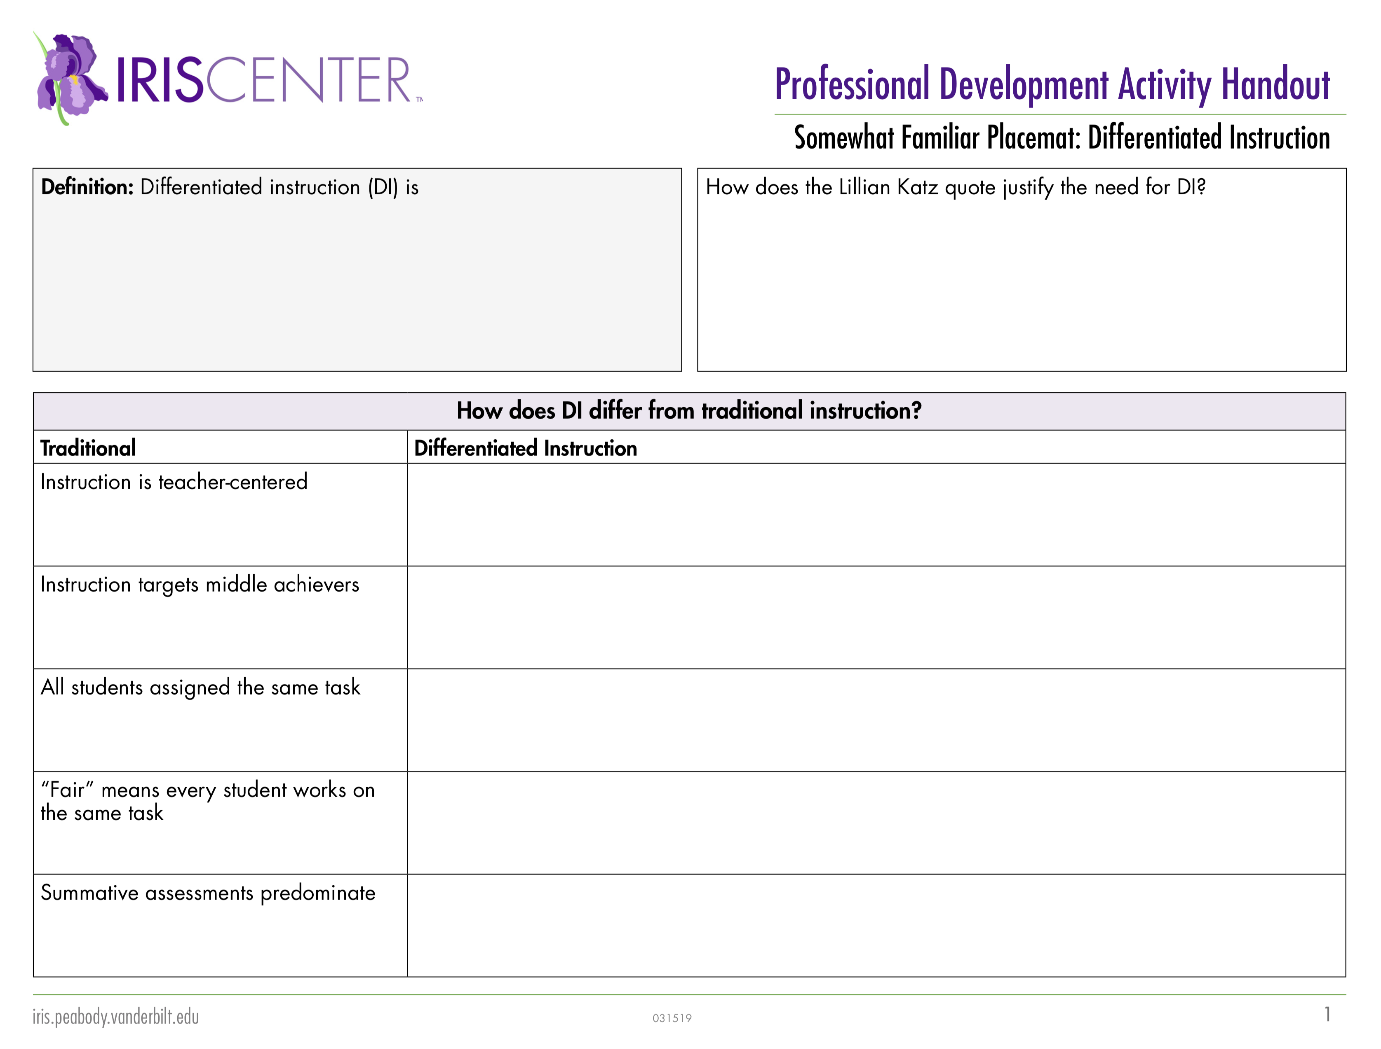
Familiarity Placemat Handout
What is your overall familiarity with differentiated instruction?
Obtain the corresponding Placemat.
Independently complete the Placemat using Perspectives & Resources Pages 1-3.

Slide 9

Triad Talk Time
Break in to groups of three (if possible, from the three different levels of familiarity).
Share key points.
Note how your tasks were
varied for the different levels
of familiarity.
List questions you still have
about the information
presented on the three
module pages.

Slide 10

10-Minute Break
Take a 10-minute break.
Come back ready to form diverse groups.

Slide 11

Expert Groups
Participants should be sitting with their diverse Expert Group.
Each familiarity color card should by represented at the table.
Goal: To form a diverse group based on familiarity with differentiated instruction.

Slide 12
Jigsaw Activity
Expert Groups
Differentiate instructional elements (Page 4)
Differentiate content (Page 5)
Differentiate process (Page 6)
Differentiate product (Page 7)
Evaluate and grade student performance (Page 8)

Slide 13

Expert Group Instructions
Familiarize yourselves with the content of your assigned Perspectives & Resource page.
Develop a 5-8 minute lesson to teach that content to your Home Group using one of the following types of visuals:
  Hand-created
  Module-provided
  Digitally-created

Slide 14

Lunch Break
Take a 1-Hour Lunch Break
When you return from lunch, sit with your Home Group.
Be ready to present to your Home Group what you learned and created in your Expert Group.

Slide 15

Jigsaw Presentations
Expert Groups, report to your Home Group and teach them what you learned!
Experts, present in this order:
  Page 4: Differentiate Instructional Elements
  Page 5: Differentiate Content
  Page 6: Differentiate Process
  Page 7: Differentiate Product
  Page 8: Evaluate and Grade
  Student Performance
Notes:
T

Slide 16

RAFT Activity
Explore the content on Page 9.
Independently complete the RAFT activity in your handout packet.
When finished, discuss with your Home Group.
Notes:
Time: 15 minutes
Facilitator Notes:
Direct teachers to read the section on Page 2 about Response to Authority Figures and listen to the two experts or read the transcripts. Have them click on each title to learn more about the different cultural responses. (10 minutes)
Direct them to respond to the questions about how culture has shaped their own response to authority figures in their Participants’ Guided Notes. (5 minutes)

Slide 17

Graphic Organizer
Read module Pages 10 and 11.
In your group, create TWO graphic organizers that represent the key ideas from these pages.
Use chart paper and markers and display your graphic organizers around the room.
Remember the graphic organizer
ideas from Page 6.
Notes:
Reminder
Make chart paper and markers available for the groups to use as they create their graphic organizers.
Decide whether participants will work in their home groups or their expert groups. The best arrangement may be determined by the dynamics of the various groups’ members.

Slide 18
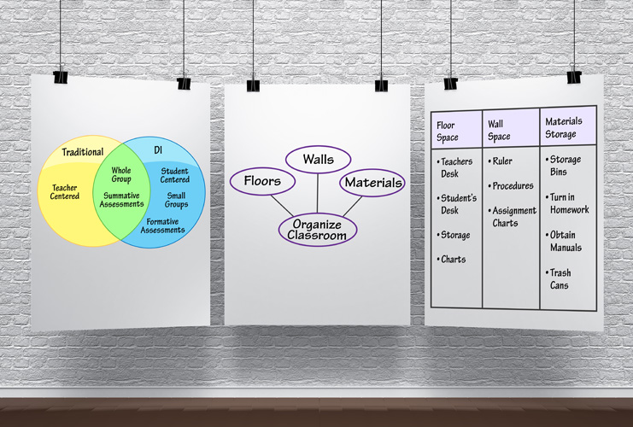
Gallery Walk
Walk around the room and view the other groups’ graphic organizers.

Slide 19

Page 12 Activity
Independently read Page 12.
In small groups complete the activity at the bottom of Page 12.
Be ready to share your
answers with the whole
group.
Notes:
Participants should return to their Home Groups for this small-group activity.

Slide 20
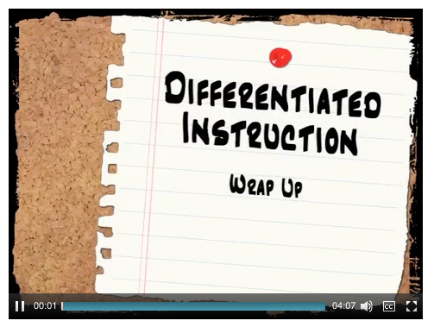
Wrap Up
Go back to the Initial Thoughts Handout and revise your answers.
Reflect on the following questions:
  How did you benefit from
  the DI activities included in
  the module?
  How can you implement DI
  in your classroom?
Notes:
As a whole group, view the Wrap Up video.

Slide 21

End-of-Course Survey
Please provide your feedback on the content of this course at:
http://iris.peabody.vanderbilt.edu/mcontent/iris_feedback/?PATH=beh1
Notes:
Direct participants to complete the short survey at the link provided before moving on to discuss next steps.

Slide 22
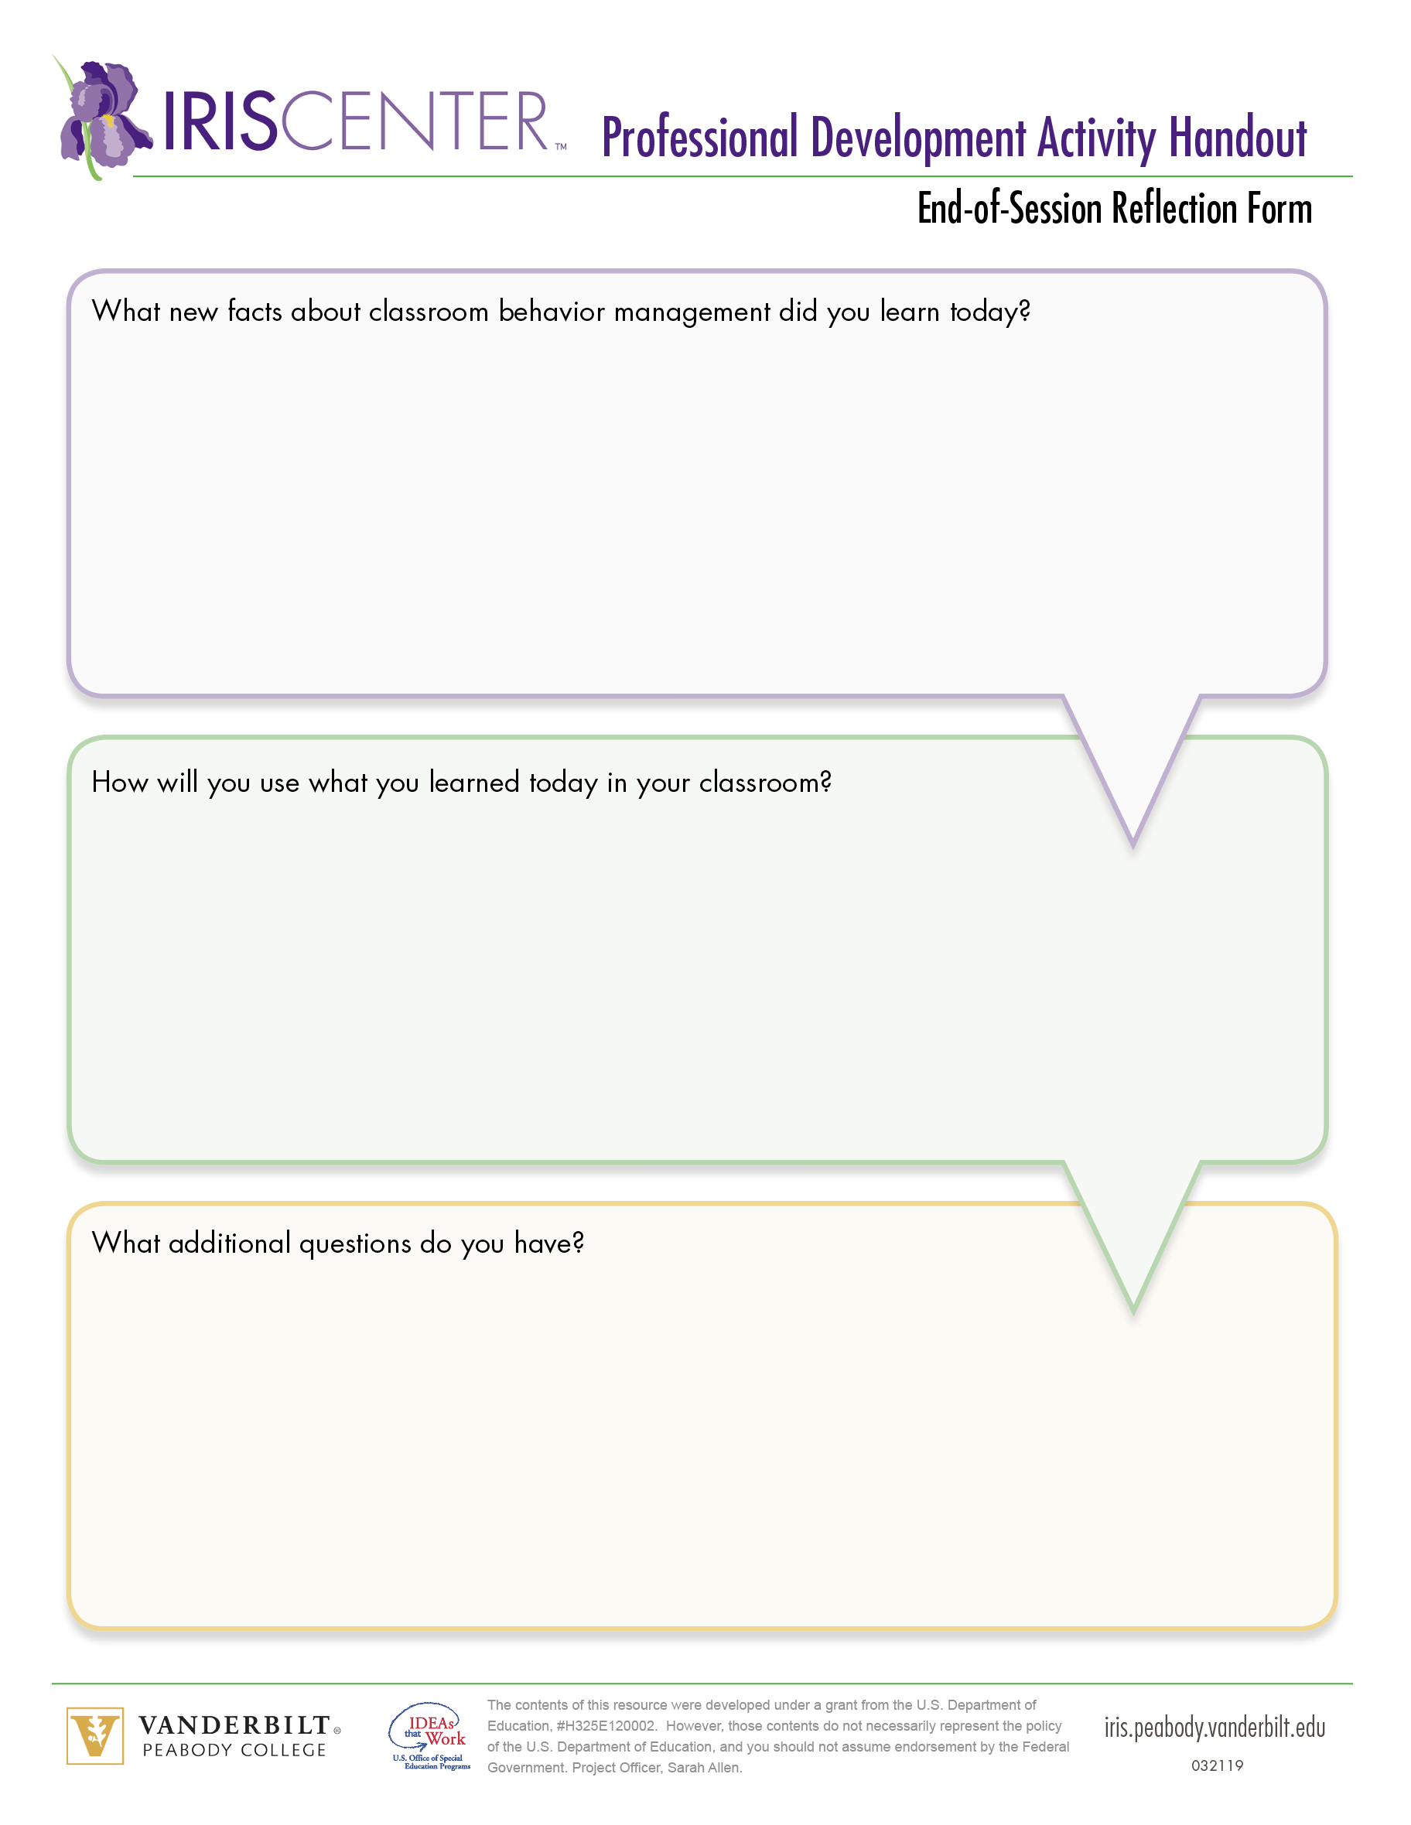
Evaluation
Complete the following before leaving:
Evaluation
End-of-Session Reflection Form
Notes:
For the remaining 15–20 minutes, ask participants to complete a facilitator-developed evaluation form or one provided by the district and the End-of-Session Reflection Form.

